Slide 1
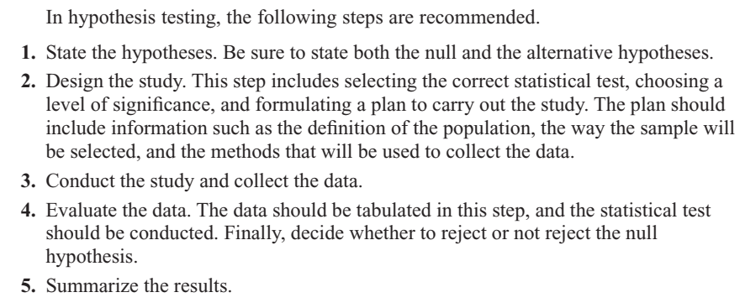
Steps in Hypothesis Testing (summary)

Slide 2
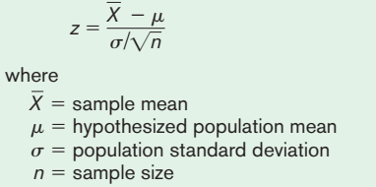
Z-test for mean
The z test is a statistical test for the mean of a population. It can be used when n > 30, or when the population is normally distributed and σ is known. The formula for the z test is

Slide 3
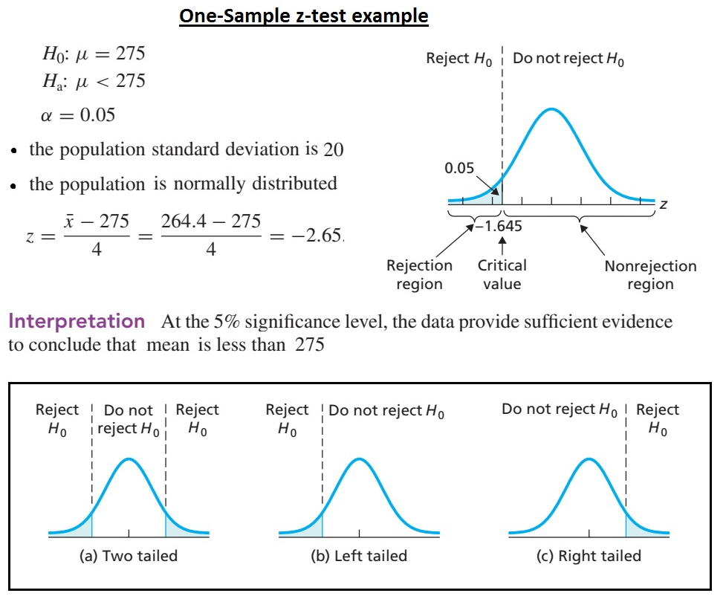

Slide 4
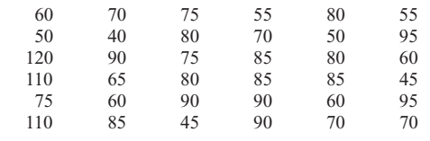
Example: Men’s Athletic Shoes
A researcher claims that the average cost of men’s athletic shoes is less than $80. He selects a random sample of 36 pairs of shoes from a catalog and finds the following costs (in dollars). (The costs have been rounded to the nearest dollar.) Is there enough evidence to support the researcher’s claim at a 0.10? Assume σ =19.2.
Notes:
Z=-1.56, Reject Ho. Xbar=75 ; p-value=0.0594

Slide 5
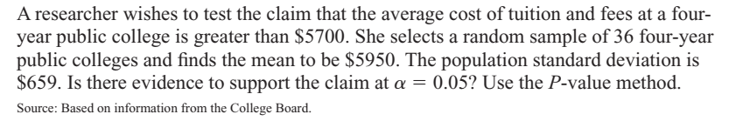
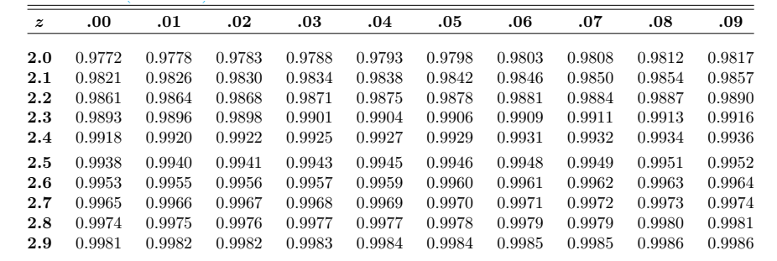
Example Tution Fees
Notes:
Z=2.28 p-value=1 – 0.9887 = 0.0113, Reject Ho

Slide 6
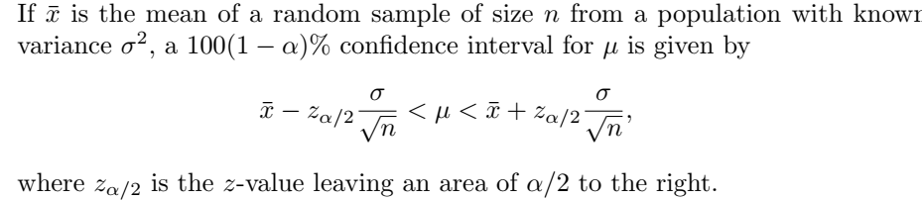
Confidence Interval on µ when σ is known

Slide 7
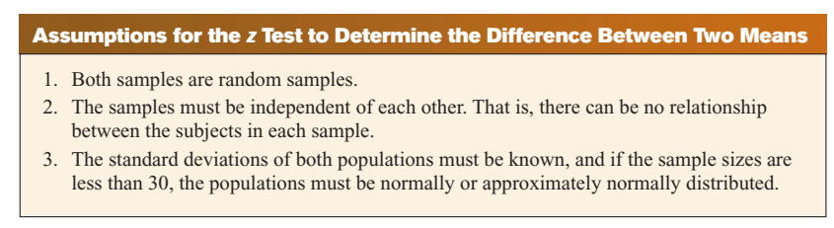
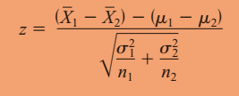
Test of Difference between two means

Slide 8
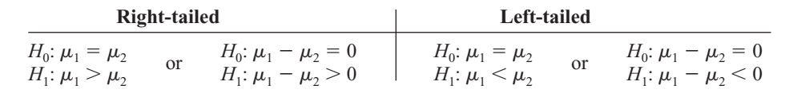
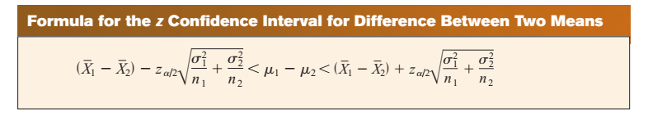
Test of Difference between two means (Contd.)

Slide 9
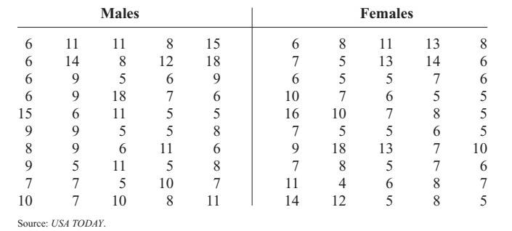
Example: Sports
A researcher hypothesizes that the average number of sports that colleges offer for males is greater than the average number of sports that colleges offer for females. A sample of the number of sports offered by colleges is shown. At α = 0.10, is there enough evidence to support the claim? Assume σ₁ and σ₂ = 3.3.
Notes:
z=1.06 (1 -- 0.8554=0.1446); Xbar1=8.6, Xbar2=7.9

Slide 10
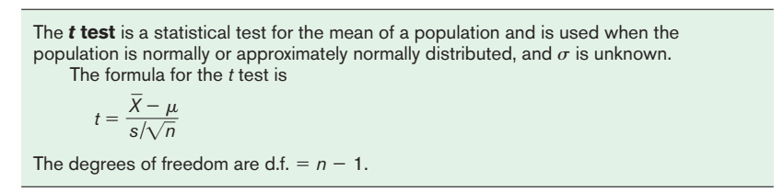
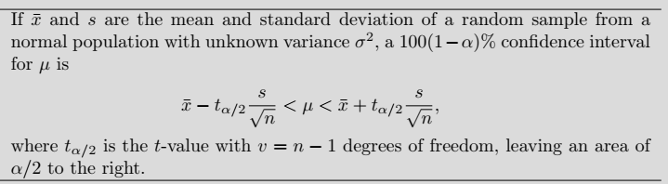
t-test for a Mean
The t-test is defined as:

Slide 11

Example: Substitute Teachers’ Salaries
An educator claims that the average salary of substitute teachers in school districts in Allegheny County, Pennsylvania, is less than $60 per day. A random sample of eight school districts is selected, and the daily salaries (in dollars) are shown. Is there enough evidence to support the educator’s claim at α 0.10?
Notes:
T=-0.264; T criticcal = 0.624 ; do not reject Ho

Slide 12
Example: Jogger’s Oxygen Uptake
A physician claims that joggers’ maximal volume oxygen uptake is greater than the average of all adults. A sample of 15 joggers has a mean of 40.6 milliliters per kilogram (ml/kg) and a standard deviation of 6 ml/kg. If the average of all adults is 36.7 ml/kg, is there enough evidence to support the physician’s claim at α = 0.05?
Notes:
T=2.517 & Reject Ho

Slide 13
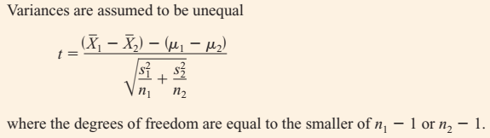
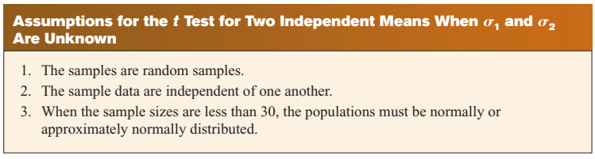
Testing Difference between two mean when σ₁≠ σ₂ (Independent Sample: t-test)

Slide 14
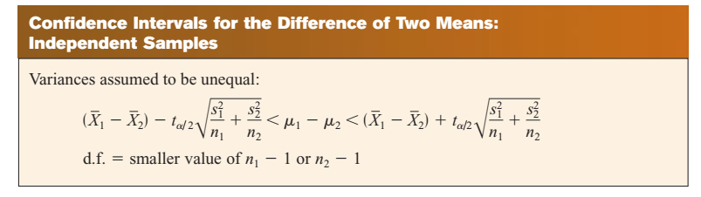

Slide 15
Example # 11
Farm Sizes: The average size of a farm in Indiana County, Pennsylvania, is 191 acres. The average size of a farm in Greene County, Pennsylvania, is 199 acres. Assume the data were obtained from two samples with standard deviations of 38 and 12 acres, respectively, and sample sizes of 8 and 10, respectively. Can it be concluded at α = 0.05 that the average size of the farms in the two counties is different? Assume the populations are normally distributed.
Find the 95% confidence interval .
Notes:
T=-0.57, Tcritical= - 2.365. Do not reject Ho.
95% CI = [ --41.02, 25.02 ]

Slide 16
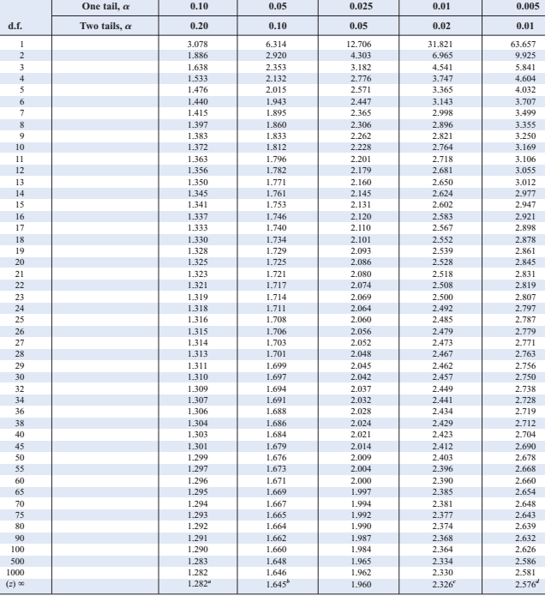

Slide 17
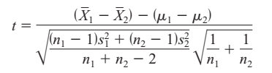
Testing Difference between two mean when σ₁= σ₂ (Independent Sample: t-test)
When the variances are assumed to be equal, this formula is used:

Slide 18
Example # 14
Test H_{o}: µ₁ - µ₂ ≤ 3 against H₁: µ₁ - µ₂ > 3 . Let α = 0.10 , σ₁= σ₂ but unknown & normally distributed populations.
Sample I: 51, 42, 49, 55, 46, 63, 56, 58, 47, 39, 47.
Sample II: 38, 49, 45, 29, 31, 35.
Notes:
T-critical = 1.341 df=15, Sp=7.41, t-calculated=2.63, reject Ho.

Slide 19
Testing the Difference Between Two Means: Dependent Samples
Samples are considered to be dependent samples when the subjects are paired, matched or related in some way.

Slide 20
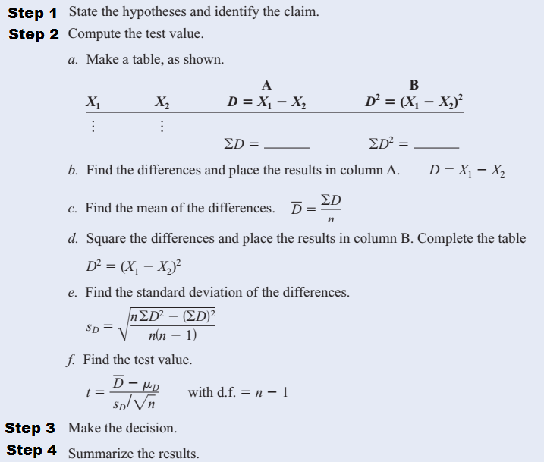

Slide 21
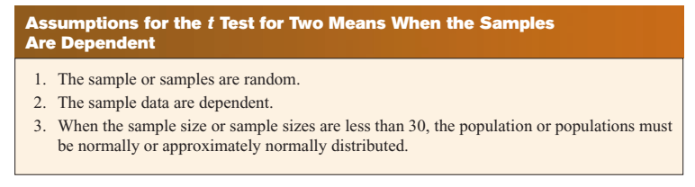

Slide 22
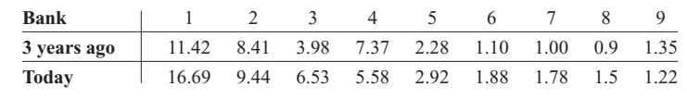
Example # 15
Bank Deposits: A sample of nine local banks shows their deposits (in billions of dollars) 3 years ago and their deposits (in billions of dollars) today. At a 0.05, can it be concluded that the average in deposits for the banks is greater today than it was 3 years ago? Use a 0.05.
Notes:
Ho: Ud=0 & H1: Ud < 0 & df=8 & Dbar= -1.081 & SDd= 1.937
T=-1.67; t-critical=-1.860.’ Do not reject Ho

Slide 23
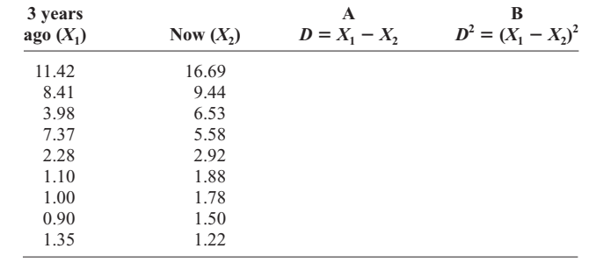
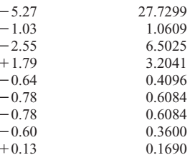
Example # 15 (contd.)
9.73
40.5437
Notes:
T= - 1.67 & t-critical=-1.860; Do not reject Ho Sd=1.937

Slide 24
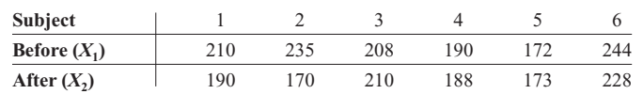
Example # 16
Cholesterol Levels: A dietitian wishes to see if a person’s cholesterol level will change if the diet is supplemented by a certain mineral. Six subjects were pretested, and then they took the mineral supplement for a 6-week period. The results are shown in the table. (Cholesterol level is measured in milligrams per deciliter.) Can it be concluded that the cholesterol level has been changed at a 0.10? Assume the variable is approximately normally distributed.
Notes:
t-criticals= +-(2.015)

Slide 25
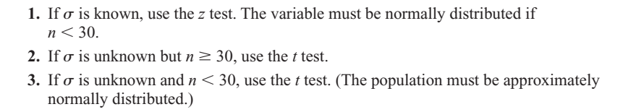
How to select correct test for testing mean
Students sometimes have difficulty deciding whether to use the z test or t test.

